Slide 1
Data scien`tist salary analysis
Tableau Project
My presentation link:
https://drive.google.com/file/d/1b8DTSxKr9Re0Y5XA77RkJkvQdn-0Ak9d/view?usp=sharing
Project link: https://drive.google.com/drive/folders/1OGbue3eeaVZYatZgoef2P0S28GQGy60W?usp=sharing

Slide 2
About
The project deals with descriptive analysis of data scientist salary of India 2021 from Kaggle.com.
Dataset row is 555 and column is 25.
A data scientist salary depends on several factors like Seniority, Job title ,industry, Sector ,Company Size ,Degree.

Slide 3
Problem Statement :
Q1.Upper and lower salary of company.
Q2.Sector vise peoples degree.
Q3.Founded year and their avg salary of the company.
Q4.Degree vise upper and lower salary.
Q5.In Industry age vise avg salary.
Q6.Avg Salary city vise.
Q7.sector vise job in excel , python ,Bi ,mongo , Sql ,Sas ,Tableau ,Google an.
Q8.Avg salary of all company depends on job title and size of company.

Slide 4
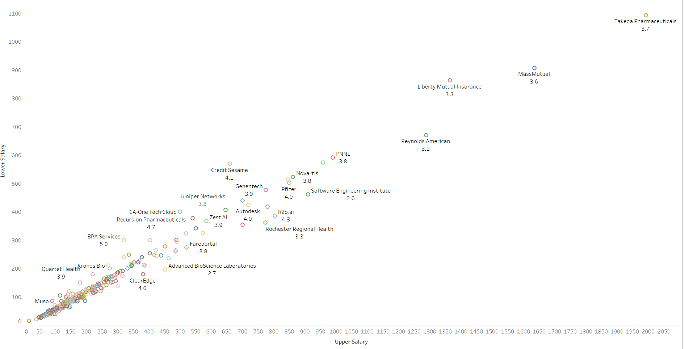
Salary of Company
The data scientist salary depends on the degree.
Most of the time data scientist salary decide on the degree like master, post graduate and nothing any .
Salary is categorized in upper and lower salary based on the degree.
Master degree has the upper salary in the industry.

Slide 5
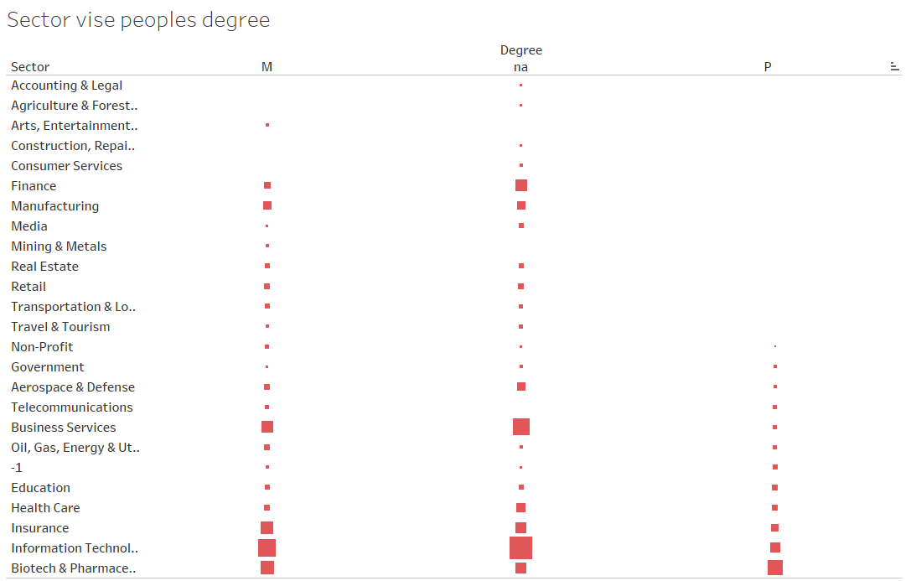
Sector vise degree for job title
In the company different sector defined the salary based on the degree .
In this image indicates the sectors and their degree vise salary distribution.
Information technology sector has highest avg salary gives master and NA degree

Slide 6
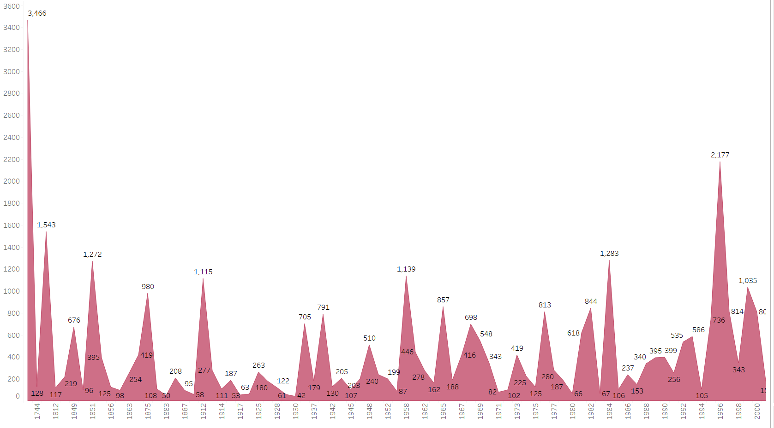
Founded year and their avg salary of company
Company details founded in which year and their avg salary that gives to data scientist based on the size of the company and the industry.

Slide 7
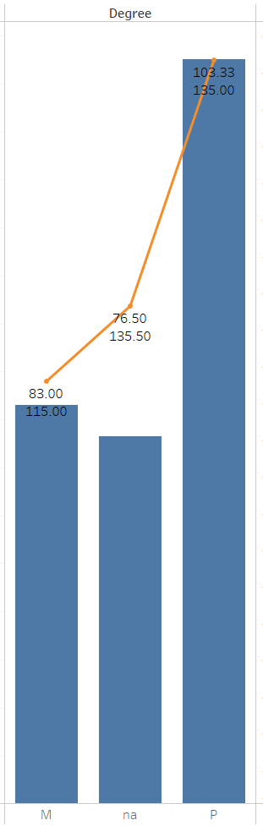
Degree vise upper and lower salary of job tital
In This slide blue bar indicates the lower salary and orange line indicates the upper salary of the job title.
Upper and lower salary depends on the degree of the job title.

Slide 8
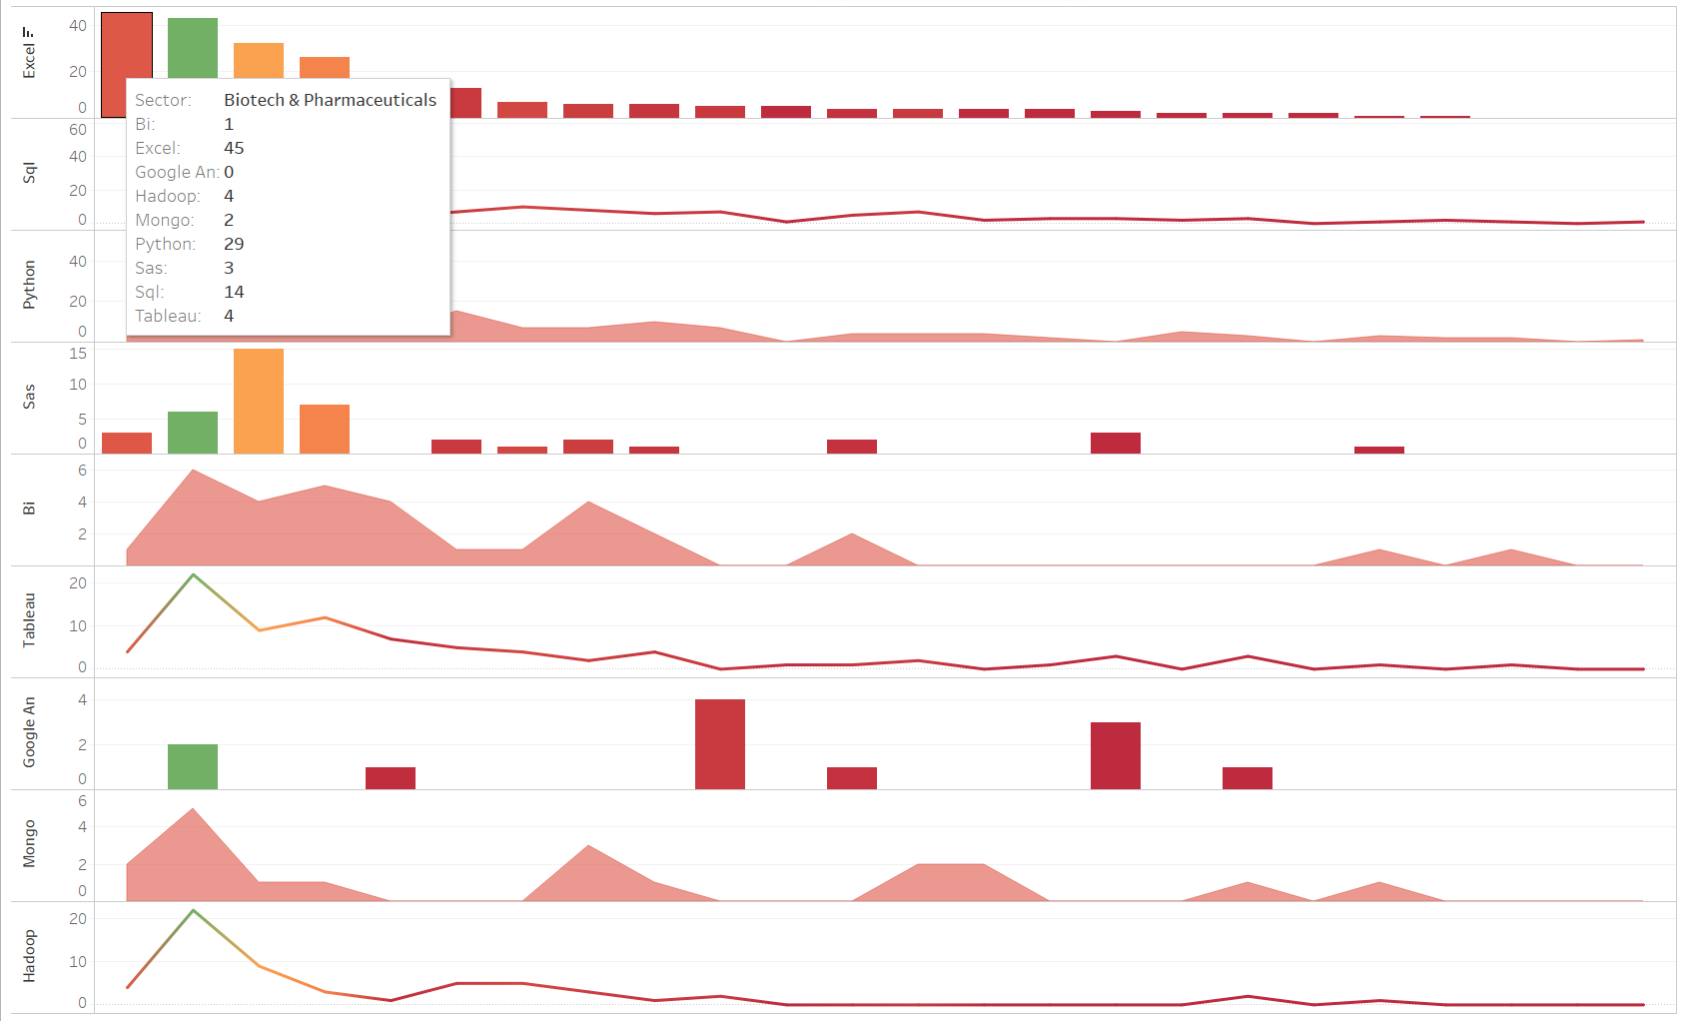
Sector vise job in different technology
In all Sector gives different technology has different pay scale.
This graph shows Excel, Sql ,Python , Sas , BI , Tableau ,Google an, Mongo and Hadoop
Opportunity to data scientist.

Slide 9
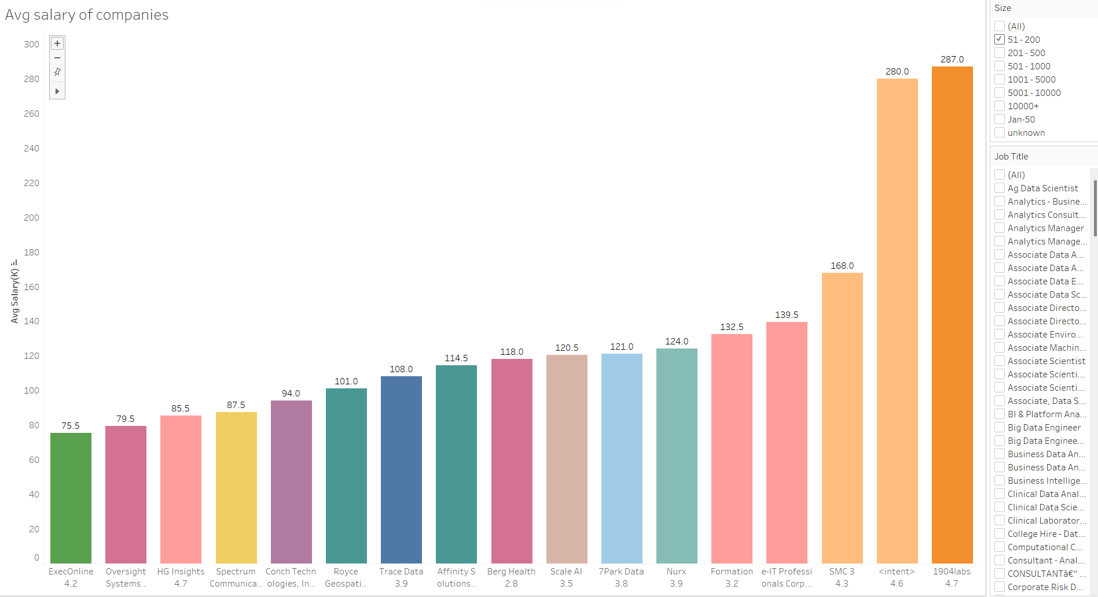
Avg salary of companies
Each company pay the different salary that depends on the size of the company and job title.
“Samba Tv “ pay highest avg salary to data scientist.
Highest PayScale depends on the seniority of title.

Slide 10
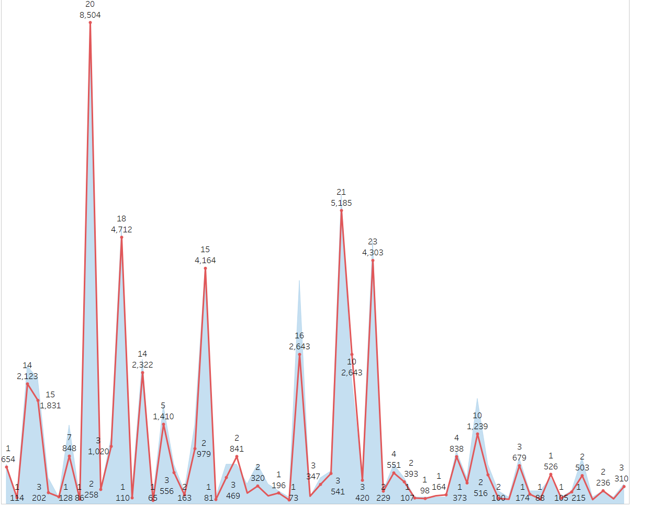
Industry vise age and salary
Age of job title and their avg salary is different based on industry.
This chart shows the age and their avg salary based on the industry.

Slide 11
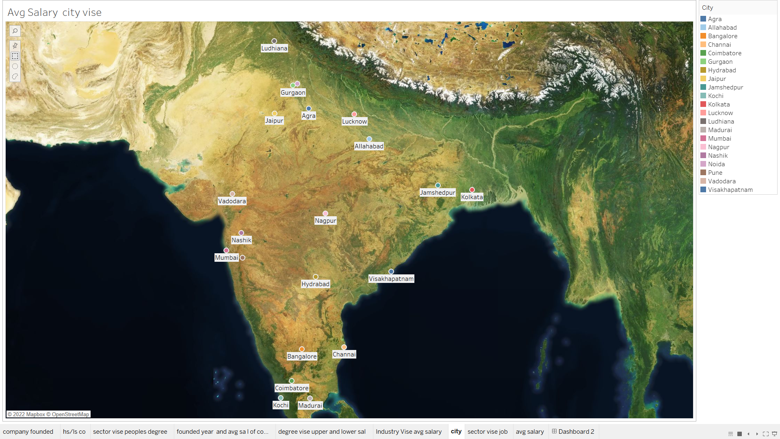
Maximum pay City's

Slide 12
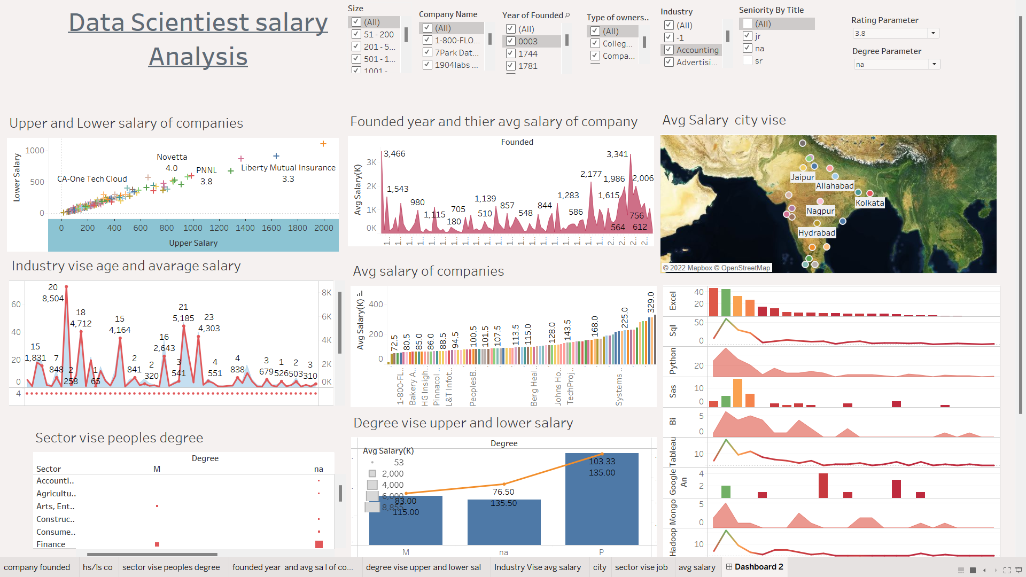
Analysis of data Scientist salary

Slide 13
CONCLUSION:
1.Highest salary provide the Biotech & Pharmaceuticals industry.
2.Master degree has highest pay scale.
3.Agra , Visakhapatnam, Jamshedpur has maximum opportunity in data scientist.
4.Seniar of data scientist has highest pay scale increase based on the seniority.
5. Information technology sector has highest avg salary gives master and NA degree.
6.“Samba Tv “ pay highest avg salary to data scientist.

Slide 14
Thank you

